Slide 1
Unlocking Potential
Dyslexia, Dyspraxia, AD(H)D and ASD Awareness for OH Professionals

Slide 2
Welcome & Introductions
Nicola James, BSc (Hons), MSc, MBPsS
Chartered Occupational Psychologist
Notes:
Explain who I am
Explain structure of the day

Slide 3
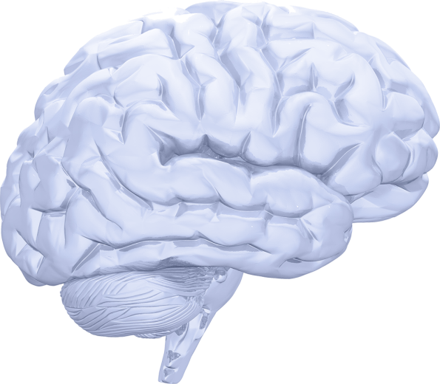
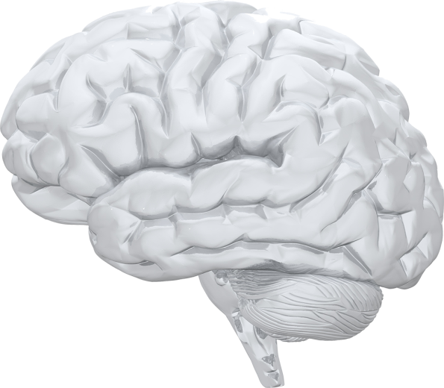
Every brain thinks a little differently...
But some brains process information very differently to others!
Copyright: Lexxic Ltd 2017

Slide 4
Famous People with Neurodiverse conditions-Who are they?
“You’re always moving and thinking about a whole bunch of things. But those traits work well for me in studios and in meetings about creative ideas. If you listen to the songs I write, they are the most ADHD songs ever. They have five hooks in one and it all happens in three minutes. I figured out a way of working with it.”
“Perhaps my early problems with dyslexia made me more intuitive: When someone sends me a written proposal, rather than dwelling on detailed facts and figures, I find that my imagination grasps and expands on what I read.”
“I failed in some subjects in exam, but my friend passed in all. Now he is an engineer in Microsoft and I am the owner of Microsoft.”

Slide 5
Famous People with Neurodiverse conditions-Who are they?
"Dyslexia is like a wall... it's very difficult to see over it. I was really lucky because I had acting... it was like a carrot that was being dangled in front of me because I had to be able to read those lines in order to do it. It doesn't mean that you're stupid... it just means that you work in a different way.“
“Here’s to the crazy ones. The misfits. The rebels. The troublemakers. The round pegs in the square holes. The ones who see things differently. They’re not fond of rules. And they have no respect for the status quo. You can quote them, disagree with them, glorify or vilify them. About the only thing you can’t do is ignore them. Because they change things. They push the human race forward. And while some may see them as the crazy ones, we see genius. Because the people who are crazy enough to think they can change the world, are the ones who do”
“Don’t tell me you’re just like me. You’re not like me. I’m unique.”

Slide 6
Famous People with Neurodiverse conditions-Who are they?
Will.i.am, Grammy-winning singer and producer
Richard Branson-founder of Virgin
Bill Gates-Founder of Microsoft
Keira Knightly-actress
Steve Jobs-Founder of Apple
Lord Alan Sugar-Founder of Amstrad

Slide 7
AD(H)D
COGNITIVE
DIFFICULTIES
DYSLEXIA
DYSPRAXIA
DIFFERENT BRAINS MEAN NeuroDifferences
DYSCALCULIA
AUTISM SPECTRUM DISORDER
MEMORY ISSUES
Copyright: Lexxic Ltd 2017
Notes:
Important to highlight that dyspraxia and dyslexia come about because the individual’s brain processes information in a different way

Slide 8
Neurodiversity
Dyslexia
Difficulties with:
reading, writing,
spelling, speaking,
listening.
Preference for
non-linear thought.
Dyspraxia
Difficulties with planning,
movements, co-ordination and practical tasks as well as
tracking and balance, poor
spatial awareness and
muscle tone.
Dyscalculia, difficulties with number concepts and calculation
Autism spectrum disorder
(ASD)
Including Asperger’s
syndrome
Social and communication
problems. Obsessive interests.
Difference in imagination.
AD(H)D
Impulsive,
temper outbursts,
hyperactivity,
low frustration threshold,
easily distracted
or over focused.
Over and under sensitive to light, noise, touch and temperature. Speech
and language difficulties.
Neuro - Diversity difficulties with organisation, memory, concentration, time, direction, perception, sequencing. Poor listening skills. All may lead to low self esteem, anxiety, and depression if others are not aware. Can be creative original and determined.
Lack of concentration, distractibility.

Slide 9
Equality Act (2010)
The act explains*:
Employers must not discriminate against disabled people - and must make reasonable adjustments to support a disabled employee, so not to put them at a disadvantage.
A disabled person is defined as having "a physical or mental impairment which has a substantial and long-term adverse effect on their ability to carry out normal day-to-day activities." Substantial is defined as ‘more than trivial’.
This could apply to neuro diverse conditions
*This explanation is provided for educational use only and does not constitute legal advice.
Copyright: Lexxic Ltd 2017
Notes:
The Equality Act 2010 is the UK law that bans unfair treatment and helps to achieve equal opportunities in the workplace, schools and in wider society.
The act replaces previous antidiscrimination laws (e.g. Sex Discrimination Act 1975, Race Relations Act 1976 and the Disability Discrimination Act 1995) with a single act, making the law simpler.
It makes the legislation easier for people to understand and to comply with. The act also strengthens protection in some situations, especially in disability discrimination.

Slide 10
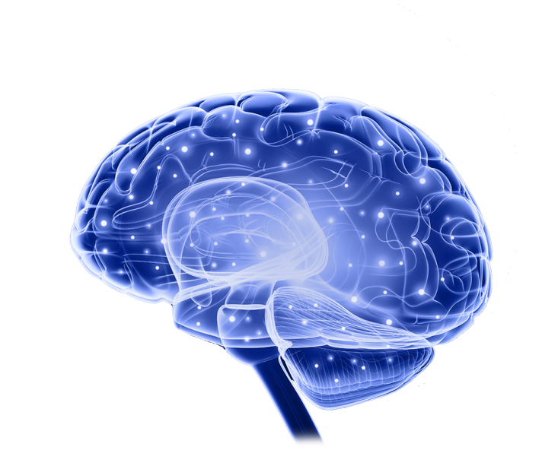
What is Dyslexia?
Specific learning difficulty (SpLD)
Affects the way an individual processes
information in their brain
Does not imply low intelligence or poor educational potential
Characterised by difficulties with:
Phonological processing (sounds in words)
Visual processing skills (e.g. tracking a series of numbers/ speed of processing)
Working memory (processing auditory information quickly and accurately)
→ Undermine the acquisition of literacy and numeracy
Notes:
Information Processing.
Difficulties with taking in information efficiently (this could be written or auditory).
Slow speed of information processing, such as a 'penny dropping' delay between hearing something and understanding and responding to it.
Memory.
Poor short term memory for facts, events, times, dates.
Poor working memory; i.e. difficulty holding on to several pieces of information while undertaking a task e.g. taking notes as you listen, coping with compound questions.
Inability to hold on to information without referring to notes.

Slide 11
What is Dyslexia?
Typical difficulties :
Reading including speed, accuracy & retention
Writing/ structuring letters or reports, particularly under timed conditions/ time pressure
Note-taking
Spelling
Concentration and attention
Organisational skills & time management
Memory for formulae or facts or following multiple instructions
Mitigated by correct teaching, strategy development and the use of information technology
Notes:
Where literacy has been mastered, residual problems generally remain such as erratic spelling, difficulty extracting the sense from written material, difficulty with unfamiliar words, an inability to scan or skim text.
Particular difficulty with unfamiliar types of language such as technical terminology, acronyms.
(highlight that people often think issues only with reading/writing)

Slide 12
Dyspraxia
Dyspraxia is a disorder characterised by impairment in the ability to plan and carry out sensory and motor tasks.
Poor balance, e.g. difficulty riding a bicycle
Can be clumsy, tendency to fall, trip, bump into things
Short term memory issues
Difficulties interpreting body language, judging tone of voice
Tendency to be over-sensitive to noise
Poor hand eye coordination
Difficulties with organising and planning

Slide 13
What is Autism Spectrum Disorder (ASD)?
“I can listen better if I don’t make eye contact”
Difficulty with social communication, interaction & imagination
Restricted, repetitive patterns of behaviour, interests, or activities
Sensory sensitivities (to light, sound, taste, smell and touch) – over or under sensitive – can cause day to day impairment
National Autistic Society
Notes:
READ FIRST: Spectrum condition – some individuals are low functioning, others are high functioning. Asperger's is the term for high functioning ASD.
ASD manifests differently in people; no one is the same, however, it is characterised by triad of impairments:
Social communication: may appear socially awkward, difficulty understanding jokes/ sarcasm, take things LITERALLY (e.g. ‘break a leg’), understanding non-verbals is a challenge, including body language & facial expressions. Eye contact very difficult!
Social interaction: difficulty with friendships and reading emotions is hard. Most ASD clients I’ve worked with say that friendships are just too hard so they often don’t bother with them. Working co-operatively can also be hard, e.g. tend to be blunt and to the point, sometimes take office banter too far. Others can take offense when this is not intended. Tendency to talk about themselves and their interests at length: don’t notice when others r bored.
Imagination/ flexibility of thought: Hard to see from another’s point of view. Also difficulty coping with changes in their routine; can become anxious or upset if their routine is disrupted/ things don’t go to plan. Routines and often very strict & detailed. For example, meals during the day, workouts in the gym (Timea)
Special interests - Intense interests in specific topics/ hobbies (e.g. trains, computers, music)- Collecting items - Can be remarkably knowledgeable in their area of interest
Repetitive movements For example, rocking, tapping - Thought to provide comfort and/ or stimulation
Sensory sensitivities – which I will talk about in a few minutes
Prevalence: more than 1 in 100 people with ASD
Only 15% of adults with ASD in the UK are in full-time paid employment
79% of those on Incapacity Benefit express desire to work | 26% of graduates with ASD are unemployed

Slide 14
“distracted by what is going on in my head”
What is AD(H)D?
Inattention
Lack attention to detail
Hard to focus thoughts - easily distracted and jumps between task
Hyperactivity
Inability to relax/ sit still – feeling restless
Constant talking
Impulsivity
Making decisions without consideration
Impatience (queues, conversations, tasks)
Notes:
So, we are moving on now to look at ADHD, AKA Attention Deficit (Hyperactivity) Disorder. 3 core symptoms:
Inattention: may find admin tasks boring; easily distracted by things in their environment
Hyperactivity: high energy, an event like today might be hard to focus on
Impulsivity: interrupt conversations or say things they will regret. Might overspend. They might get impatient and drive erratically or engage in other risky behaviours.
NOTE: Each individual with ADHD has a different set of challenges. Not every person with ADHD has all 3 symptoms- Some people predominately hyperactive and impulsive, others are mainly inattentive - also severity varies.
Impacts on:
Organisation and time management
Completing paperwork
Getting to work on time
Wellbeing and mental health
“How does ADHD affect an adult’s work or job?
Adults with ADHD are at increased risk for lower job performance and social problems (including problems with co-workers and conflicts with their boss or supervisor). They have a greater chance of changing jobs more frequently due to these problems.
A typical problem is an employee who doesn’t turn in work (such as a presentation or report), even though it has been completed. Many have “chaotic” desks, offices or briefcases.”
Associated impairments - Can feel exhausted by the effort of sustaining attention, Impact on social interactions/ relationships , Low self-esteem, Impacts on functioning at work and in academic settings, Variable performance (excellent at some tasks), Increased risk of anxiety/ depression and other comorbidities, Sleep problems
Adult symptoms more subtle than in childhood
Hyperactivity likely to reduce in adulthood
Commonly appears with other conditions, e.g. Dyslexia
Myths about ADHD
It isn’t a real disorder
Lazy, don’t want to focus, need to try harder
Only affects males
Children grow out of it
Reasons for misunderstanding?
Symptoms of AD(H)D are similar to experiences that we all have in our daily lives
In Adult AD(H)D - far more persistent and severe, impacts on daily functioning

Slide 15
How Lexxic can help?
Lexxic offers organisations a three-stage solution for supporting employees with neurodifferences
1. Screening & Assessment
We screen for neurodifferences, assess history and severity of the condition and produce a report.
2. Workplace Assessment
We examine the work environment and job tasks to recommend adjustments and support.
3. Specialist Support
We provide specialist support including group training, one on one coaching, eLearning.
Contact Lexxic at 08456432754 or enquiry@lexxic.com
Visit the website for more information on each service offered: www.lexxic.com
Copyright: Lexxic Ltd 2017
Notes:
Also ADHD, ASD etc

Slide 16
Examples of Best Practice Adjustments for Dyslexia/ Dyspraxia/ AD(H)D and ASD
Copyright: Lexxic Ltd 2016

Slide 17
Reading - How can you help?
Text-to-speech software (also great for proofreading)
Quiet location to avoid visual and auditory distractions
Active reading techniques (using highlighters, note-taking)
Using music to block out distractions
Coloured overlays
Send emails with bullet points and clear instructions.
Offer to discuss the information before and/ or afterwards
Allow extra time
Proofreading checklist
Provide reading materials in advance

Slide 18
Writing and Spelling - How can you help?
Provide best practice examples (what ‘good’ looks like)
Provide templates and prompting questions
Provide clear instructions about what is to be included
Text-to-speech software for proofreading
Speech-to-text software for writing
Mindmapping
Leeway on targets or extra time for writing tasks
Proofreading and accuracy checklist

Slide 19
Concentration – How can you help?
Provide squeezy ball e.g. in meetings; for reading
Encourage short physical break every 45 minutes
Verbalise their thoughts to aid concentration
Job aligns with strengths-practical element to role
Use of a quiet meeting room
Move desk to a quieter area
Encourage to block out time in the diary
Tomato Timer

Slide 20
Verbal Articulation - How can you help?
Encourage the individual to discuss their ideas prior to the meeting/presentation
Encourage them to practise articulating their thoughts
Give encouraging and constructive feedback
Give advanced notice of presentations
Provide templates and prompting headings to structure their ideas

Slide 21
Organisation - How can you help?
Regular meetings to discuss priorities and status of projects
Encourage to ask for deadlines, and help to set deadlines when none are given
Break down larger tasks into smaller chunks and set deadlines
Provide logical checklists to work through
Reduce interruptions during tasks – encourage to finish a task before pausing/ moving to new task
Create a set structure for the working week and enter this into the calendar
Encourage to keep task lists and To Do lists

Slide 22
Confidence – How can you help?
Highlight their strengths and the positives they bring to the team – write this down in a one-to-one meeting
Provide specific positive feedback, before any developmental feedback
Encourage them to reflect on their achievements
Send them encouraging emails
Praise them when they have achieved their goals
Encourage them to take a solution orientated approach

Slide 23
Specialist Autism Spectrum Disorder Adjustments
Communication - avoid abstract language
Reminders of boundaries – interrupting conversations
Support training and a buddy
Develop routines and set structure
Provide advanced notice of changes at work
Fixed hours and workstation
Private office or meeting room/ relaxation space
Enable easy control of lighting and temperature
Notes:
Communication – in a clear way with minimal ambiguity, clear deadlines given
Understanding that saying the ‘wrong thing/ seeming uninterested/ pedantic is probably unintentional and likely to be due to the person’s communication difficulties
Gentle reminders about boundaries in terms of how the individual is coming across, e.g. interrupting a conversation. Rude is not intentional.
Support training to develop skills in building rapport, conversation techniques, body language. Like learning a new language. Also, one-to-one support from a buddy – to help manage unpredictable changes
Provide advance notice where possible of changes to work to minimise stress and anxiety
Allow to start later in the day when less people are around, if over sensitive to noise
Also, providing a private workspace for minimal sensory input.

Slide 24
How Lexxic can help?
Lexxic offers organisations a three-stage solution for supporting employees with neurodifferences
1. Screening & Assessment
We screen for neurodifferences, assess history and severity of the condition and produce a report.
2. Workplace Assessment
We examine the work environment and job tasks to recommend adjustments and support.
3. Specialist Support
We provide specialist support including group training, one on one coaching, eLearning.
Contact Lexxic at 08456432754 or enquiry@lexxic.com
Visit the website for more information on each service offered: www.lexxic.com
Copyright: Lexxic Ltd 2017
Notes:
Also ADHD, ASD etc

Slide 25
Lexxic Results
Based upon the three-stage approach, neurodiverse employees typically report:
Diagnosis is a relief and helps them understand themselves better
Their difficulties in their job are minimised based on a range of adjustments and support
They feel empowered by strategies they can use to better manage themselves
They experience improvements in productivity and wellbeing at work
Copyright: Lexxic Ltd 2017

Slide 26
NEW Lexxic Services
PHONE SERVICES: We offer phone based workplace assessments
WORKSHOPS: We offer a range of group workshops for Line Managers, HR Staff and Occupational Health Professionals on Neuro-diversity
MINDFULNESS: We offer Mindfulness training to proactively support mental health and wellbeing
eLEARNING: We provide eLearning to make training for dyslexia and related conditions available
eCourses
Copyright: Lexxic Ltd 2017

Slide 27
Neurotalent Unlocked eLearning Platform
Video based skills development – filmed in high definition
Real stories from people with neurodiverse conditions
SFE approved software accessible on all devices

Slide 28
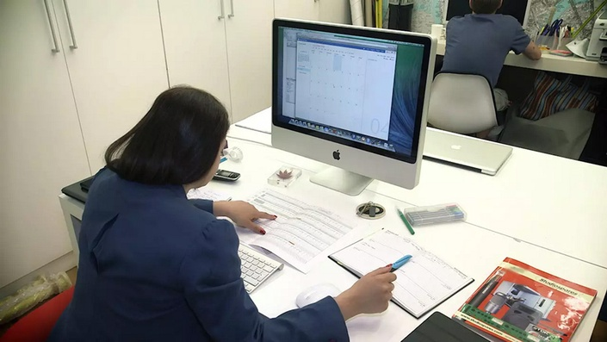
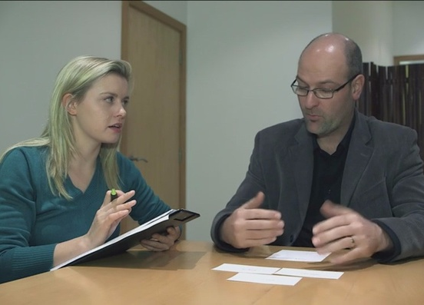
Modular Focus with Bite-sized Chapters
1. Improving your Reading Enhance your reading speed, as well as your ability to understand and recall information quickly. | 2. Improving your Writing Improve your skills for writing and creating documents in professional and educational scenarios. | 3. Organising your Workload Learn how to manage yourself and your time. Create study plans and plan your day to day tasks. | 4. Listening, Concentrating and Note Taking Enhance your listening, concentration and note taking skills while staying calm and in control.

Slide 29
Any Questions?

Slide 30
Contact Lexxic
To discuss your situation, arrange an assessment, and to learn more about our services, you can contact Lexxic as follows:
Telephone: 0845 643 2754
Email: enquiry@lexxic.com
Website: www.Lexxic.com
Copyright: Lexxic Ltd 2017

Slide 31
Keep up to date with Lexxic!
Free newsletter
Inspiring stories from clients and others in the neuro-differences community
Advice, developments and best practice
Signup at www.Lexxic.com
@LexxicLtd

