Slide 1
Diabetes treatment options
Dr Theingi Aung
Endocrinologist
Royal Berkshire Hospital
12th Jan 2018

Slide 2
What would your ideal diabetes drug do?
Effective in lowering HbA1c
No hypoglycaemia
No effect on weight/ weight loss?
Reduce CV risk
Also reduce lipids and B.P.?
Few/ no side effects
Safe

Slide 3
Main classes of oral drugs available
Biguanides (Metformin)
Sulphonylureas (Gliclazide, Glimiperide, Glibencalmide etc)
Thiozolendinediones (Pioglitazone)
Glinides (Replaglinide, nataglinide)
Alpha-glucosidase inhibitors (Acarbose)
DDP-4 inhibitors or Gliptins (Sitagliptin, Saxagliptin,Linagliptin, Vildagliptin, Allogliptin)
SGLT2 inhibitor agents (empagliflozin, cangligliflozin, dapagliflozin)
Coming soon dual SGLT1/2 inhibitor agents

Slide 4
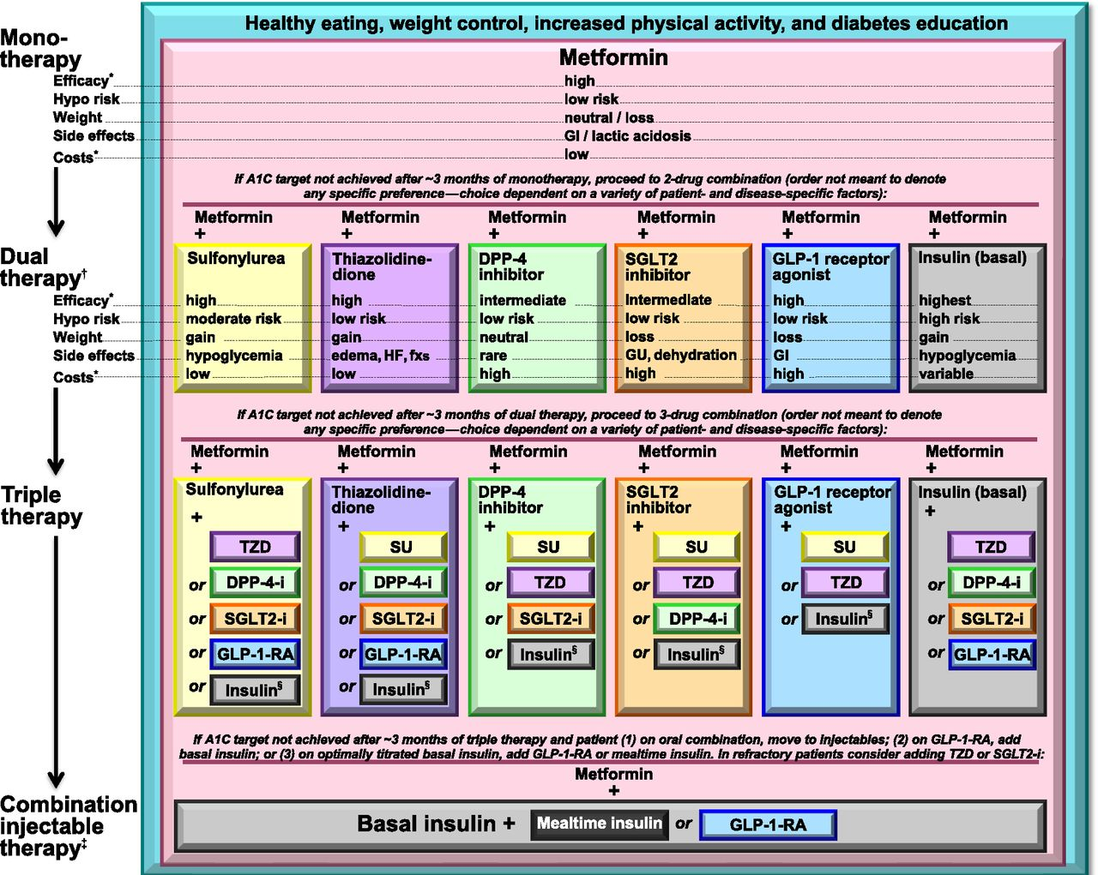
Diabetes Care 2015 Jan; 38(Supplement 1): S41-S48. http://dx.doi.org/10.2337/dc15-S010
Notes:
If the A1C target is not achieved after approximately 3 months, consider a combination of metformin and one of these six treatment options: sulfonylurea, thiazolidinedione, DPP-4 inhibitors, SGLT2 inhibitors, GLP-1 receptor agonists, or basal insulin (Fig. 7.1). Drug choice is based on patient preferences as well as various patient, disease, and drug characteristics, with the goal of reducing blood glucose levels while minimizing side effects, especially hypoglycemia. Figure 7.1 emphasizes drugs commonly used in the U.S. and/or Europe.

Slide 5
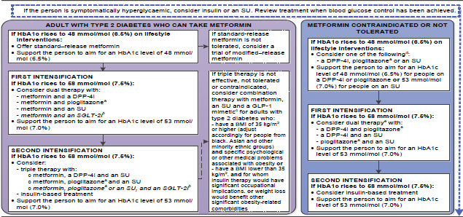
NICE-DM guideline-2015

Slide 6
Metformin
Is the basis for the oral treatment of most people type II diabetes
Introduced in 1957, has a proven track record of efficacy and safety
Lowers blood glucose with a low risk of hypoglycaemia with modest weight loss
UK PDS suggest that it reduces cardiovascular events although subsequent studies less certain.
Generally well-tolerated
Notes:
Metformin is the recommended first-line oral glucose-lowering drug initiated to control hyperglycemia in type 2 diabetes mellitus. It acts in the liver, small intestines, and skeletal muscles with its major effect on decreasing hepatic gluconeogenesis. It is safe, inexpensive, and weight neutral and can be associated with weight loss. It can reduce microvascular complication risk and its use is associated with a lower cardiovascular mortality compared with sulfonylurea therapy. It is also used to delay the onset of type 2 diabetes mellitus, in treating gestational diabetes, and in women with polycystic ovary syndrome.

Slide 7
Metformin mechanisms of action
Metformin decreases hyperglycemia primarily by suppressing glucose production by the liver
Mechanism of metformin is incompletely understood
Increases insulin sensitivity, enhances peripheral glucose uptake to muscle

Slide 8
Adverse effects of metformin
Gastrointestinal intolerance
Risk of acute kidney injury with other medications add x-ray contrast material
Lactic acidosis
  with renal impairment
  Heart failure
  Liver disease
Reduced TSH
B12 deficiency
Notes:
Stop metformin if the eGFR is below 30 ml/minute/1.73m².
Prescribe metformin with caution for those at risk of a sudden deterioration in kidney function and those at risk of eGFR falling below 45 ml/minute/1.73m²

Slide 9
Metformin
Safe
Inexpensive
Weight neutral/associated with weight loss
Can reduce microvascular complication risk
Lowered CV mortality compared with sulfonylurea

Slide 10
Sulphonylureas
First generation drugs
  carbutamide, acetohexamide, chlorpropamide, and tolbutamide.
Second generation drugs
  glipizide, gliclazide, glibenclamide, glyburide, glibornuride,gliquidone, glisoxepide, and glyclopyramide.
Third generation drugs
  glimepiride

Slide 11
Sulphonylureas
Increase insulin secretion through opening up a potassium channel in islets cells
Cause insulin release unrelated to blood glucose
Are powerful glucose lowering agents in early type II diabetes but are less effective with longer duration diabetes
Adverse effects are hypoglycaemia weight gain and there are concerns about increased risk of cardiovascular events
Accumulate in in the elderly and should be used with caution

Slide 12
Glinides
Repaglinide and Nataglinide
Act in a similar manner to sulphonylureas but has shorter duration
Excreted via GI Tract, so safe in renal impairment and elderly
Useful to control post meal glucose

Slide 13
Pioglitazone
Effective
No hypoglycaemia as monotherapy or with metformin
Long duration of effectiveness
Reduction in CVS events
May help with NAFLD
Weight gain
Can cause osteoporosis
Can precipitate heart failure due to fluid overload
Notes:
In adults with type 2 diabetes, do not offer or continue pioglitazone^{[4]} if they have any of the following:
heart failure or history of heart failure
hepatic impairment
diabetic ketoacidosis
current, or a history of, bladder cancer
uninvestigated macroscopic haematuria (2015).

Slide 14
PROactive: Reduction in primary outcome
All-cause mortality, nonfatal MI (including silent MI), ACS, revascularization, leg amputation, stroke
25
10% RRR
HR* 0.90 (0.80–1.02)
P = 0.095
20
Placebo
(572 events)
Pioglitazone
(514 events)
15
Proportion
of events
(%)
10
5
0
0
6
12
18
24
30
36
Time from randomization (months)
Number at risk
Pioglitazone
2488
2373
2302
2218
2146
348
Placebo
2530
2413
2317
2215
2122
345
*Unadjusted
Dormandy JA et al. Lancet. 2005;366:1279-89.
Notes:
BACKGROUND:
Patients with type 2 diabetes are at high risk of fatal and non-fatal myocardial infarction and stroke. There is indirect evidence that agonists of peroxisome proliferator-activated receptor gamma (PPAR gamma) could reduce macrovascular complications. Our aim, therefore, was to ascertain whether pioglitazone reduces macrovascular morbidity and mortality in high-risk patients with type 2 diabetes.
METHODS:
We did a prospective, randomised controlled trial in 5238 patients with type 2 diabetes who had evidence of macrovascular disease. We recruited patients from primary-care practices and hospitals. We assigned patients to oral pioglitazone titrated from 15 mg to 45 mg (n=2605) or matching placebo (n=2633), to be taken in addition to their glucose-lowering drugs and other medications. Our primary endpoint was the composite of all-cause mortality, non fatal myocardial infarction (including silent myocardial infarction), stroke, acute coronary syndrome, endovascular or surgical intervention in the coronary or leg arteries, and amputation above the ankle. Analysis was by intention to treat. This study is registered as an International Standard Randomised Controlled Trial, number ISRCTN NCT00174993.
FINDINGS:
Two patients were lost to follow-up, but were included in analyses. The average time of observation was 34.5 months. 514 of 2605 patients in the pioglitazone group and 572 of 2633 patients in the placebo group had at least one event in the primary composite endpoint (HR 0.90, 95% CI 0.80-1.02, p=0.095). The main secondary endpoint was the composite of all-cause mortality, non-fatal myocardial infarction, and stroke. 301 patients in the pioglitazone group and 358 in the placebo group reached this endpoint (0.84, 0.72-0.98, p=0.027). Overall safety and tolerability was good with no change in the safety profile of pioglitazone identified. 6% (149 of 2065) and 4% (108 of 2633) of those in the pioglitazone and placebo groups, respectively, were admitted to hospital with heart failure; mortality rates from heart failure did not differ between groups.
INTERPRETATION:
Pioglitazone reduces the composite of all-cause mortality, non-fatal myocardial infarction, and stroke in patients with type 2 diabetes who have a high risk of macrovascular events.

Slide 15
PROactive: Reduction in secondary outcome
Combined nonfatal MI, all-cause mortality, stroke
25
20
Placebo
(358 events)
15
16% RRR
HR* 0.84 (0.72–0.98)
P = 0.027
Proportion
of events
(%)
10
Pioglitazone
(301 events)
5
0
0
6
12
18
24
30
36
Time from randomization (months)
Number at risk
Pioglitazone
2536
2487
2435
2381
2336
396
Placebo
2566
2504
2442
2371
2315
390
*Unadjusted
Dormandy JA et al. Lancet. 2005;366:1279-89.

Slide 16
PROactive: Reduced need for insulin
25
Placebo
(362 events)
20
53% RRR
HR* 0.47 (0.39–0.56)
P < 0.0001
15
Proportion
of events
(%)
10
Pioglitazone
(183 events)
5
0
0
6
12
18
24
30
36
Number at risk
Time from randomization (months)
Pioglitazone
1700
1654
1603
1554
1499
244
Placebo
1646
1544
1472
1401
1325
202
*Unadjusted
Dormandy JA et al. Lancet. 2005;366:1279-89.
Notes:
Ten-year observational follow-up of PROactive: a randomized cardiovascular outcomes trial evaluating pioglitazone in type 2 diabetes.
Erdmann E¹, Harding S², Lam H³, Perez A³.
Author information
¹Medical Clinic III, University of Cologne, Cologne, Germany.
²Takeda Development Centre, London, UK.
³Takeda Development Center Americas, Inc., Deerfield, IL, USA.
Abstract
AIMS:
To conduct a 10-year, observational follow-up of patients completing PROactive to investigate whether trends of cardiovascular benefit with pioglitazone and imbalances in specific malignancies persisted over time.
METHODS:
Macrovascular endpoints and malignancies were compared based on original randomization to pioglitazone or placebo and 'any' versus 'no' pioglitazone use for bladder and prostate cancer.
RESULTS:
Of 4873 patients completing the PROactive trial, 74% entered the follow-up. During follow-up (mean 7.8 years), there were no statistically significant differences in the primary [all-cause mortality, myocardial infarction (MI), cardiac intervention, stroke, major leg amputation, leg revascularization] or main secondary (death, MI, stroke) endpoints for subjects originally randomized to pioglitazone and placebo, except for leg amputations during follow-up [4.1% pioglitazone, 5.6% placebo; hazard ratio 0.74, 95% confidence interval (CI) 0.55-0.99; p = 0.046]. During follow-up, the incidence of total malignancies was similar between groups; bladder cancer was reported in 0.8% of patients (n = 14) in the pioglitazone versus 1.2% (n = 21) in the placebo group [relative risk (RR) 0.65, 95% CI 0.33-1.28], and prostate cancer was reported in 44 men (3.7%) in the pioglitazone versus 29 men (2.5%) in the placebo group (RR 1.47, 95% CI 0.93-2.34).
CONCLUSIONS:
The trends of macrovascular benefits of pioglitazone compared with placebo during PROactive did not persist in the absence of continued pioglitazone during this 10-year follow-up. Trends of decreased bladder cancer and increased prostate cancer were observed in the pioglitazone group during follow-up; however, these imbalances should be interpreted with caution because of the limitations of the observational study design.

Slide 17
Incretin-based Therapies

Slide 18


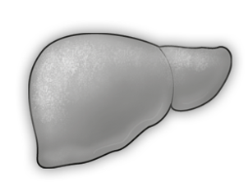

Physiology of postprandial glucose regulation
Meal
Insulin
❶
Insulin
Glucagon
Rising plasma glucose stimulates pancreatic β-cells to secrete insulin¹
Gastric
emptying
❷
Glucagon
Plasma glucose inhibits glucagon secretion by pancreatic α-cells¹
PPG
❸
Gastric emptying
Hepatic
glucose
output
Glucose
uptake
Delaying and/or slowing gastric emptying is a major determinant of postprandial glycaemic excursion²
+
PPG = postprandial glucose
¹DeFronzo RA. Med Clin North Am 2004;88:787-835
²Horowitz M et al. Diabet Med 2002;19:177-94
Notes:
Speaker Notes
In non-diabetic individuals, postprandial glucose is tightly regulated by a number of mechanisms. Three critical factors that regulate postprandial glucose following ingestion of a meal are:
An increase in insulin secretion by pancreatic β-cells
Potent suppression of glucagon secretion from pancreatic α-cells
Slowing of the rate of gastric emptying
In order to maximize post-prandial glucose reduction, these three critical factors should be addressed.
References
DeFronzo RA. Pathogenesis of type 2 diabetes mellitus. Med Clin North Am. 2004;88(4):787-835.
2. Horowitz M, O’Donovan D, Jones KL, Feinle C, Rayner CK, Samsom M. Gastric emptying in diabetes: clinical significance and treatment. Diabet Med. 2002;19(3):177-194.
Annotations
Bullet 1: DeFronzo.Med Clin North Am.July.2004/p787/lines 19-23
Bullet 2: DeFronzo.Med Clin North Am.July.2004/p789/lines 1-4
Bullet 3: Horowitz.Diabet Med.March.2002/p177/lines A14-A15

Slide 19
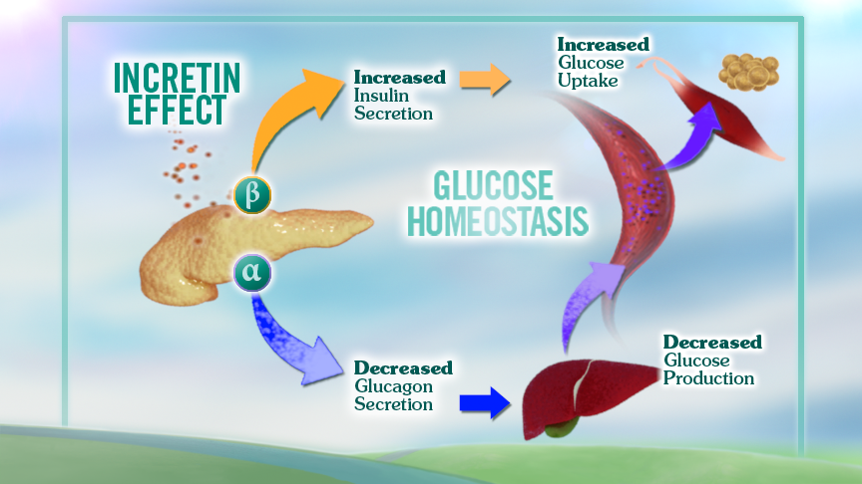
Glucagon-like peptide-1 and incretin effect

Slide 20
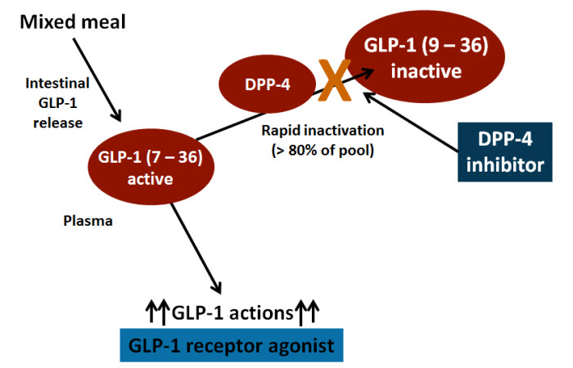

Slide 21
Incretin-based therapies
GLP-1 receptor agonists and DPP-4 inhibitors
GLP-1 receptor agonists
Short-acting BD Exenatide (Byetta)
OD Lixisenatide (Lyxumia) Long-acting OD Liraglutide* (Victoza)
Longer-acting QW Exenatide (Bydureon)
Dulaglutide (Trulicty)
DPP-4 inhibitors
Sitagliptin OD
Vildagliptin BD
Saxagliptin OD
Linagliptin OD
Subcutaneous injection
Tablets
Mimics endogenous
GLP-1
Enhance endogenous GLP-1
*Human GLP-1 analogue, others are exendin-based
DPP-4 = dipeptidyl peptidase-4; OD = once daily; BD = twice daily; QW = once weekly
Drucker DJ, Nauck MA. Lancet 2006;368:1696−1705
Notes:
The circulating levels of native GLP-1 decrease rapidly because of inactivation, mainly by dipeptidyl peptidase-4 (DPP-4) (1). To be effective, native GLP-1 would need to be infused continuously. Consequently, it is of limited clinical utility.
There are two other ways to restore the GLP-1 response:
Protect GLP-1 from inactivation by DPP-4
Develop GLP-1 receptor agonists that are resistant to DPP-4 and can mimic native GLP-1.
Both of these strategies have now been introduced into clinical practice by the development of DPP-4 inhibitors and GLP-1 receptor agonists respectively. Both classes of drug are described as incretin-based therapies.
The GLP-1 receptor agonists include exenatide and liraglutide (1). Exenatide is an exendin-based therapy. Liraglutide is a human GLP-1 analogue.
Reference
1. Drucker DJ, Nauck MA. Lancet 2006;368:1696−1705
21

Slide 22
DPP4 inhibitors
Increases GLP one and hence increase insulin secretion with hyperglycaemia
Glucose lowering effect limited
Some weight gain but reduced risk of hypoglycaemia
Very well tolerated
Concerns about heart failure with Saxogliptin and alogliptin
Notes:
It is worth noting, however, that a reduction in the dose of sulfonylureas is usually recommended when a DPP-4 inhibitor is added, because of a pharmacodynamic interaction (rather than a pharmacokinetic interaction) between the sulfonylurea and the DPP-4 inhibitor, which may result in a higher risk of hypoglycaemia. Otherwise, any gliptin may be combined with metformin or a thiazolidinedione (pioglitazone, rosiglitazone), leading to a significant improvement in glycaemic control without an increased risk of hypoglycaemia or any other adverse event in patients with T2DM

Slide 23
SGLT2 inhibitors

Slide 24
SGLTs
Canagliflozin 100-300mg od (£39.20)
Empagliflozin 10-25mg od (£36.59)
Dapagliflozin 10 mg (£36.59)

Slide 25
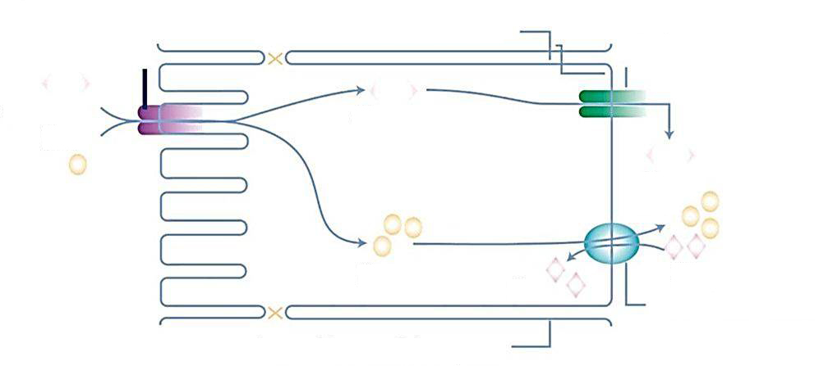
SGLT2 is a sodium glucose cotransporter^{1,2}
Segment S1–2
Basolateral membrane
SGLT2
GLUT2
Glucose
Na⁺
Glucose
Glucose
Na⁺
Na⁺
K⁺
K⁺
Na⁺/K⁺ ATPase pump
Lateral intercellular space
SGLTs transfer glucose and sodium (Na⁺:glucose coupling ratio for SGLT1 = 2:1
and for SGLT2 = 1:1) from the lumen into the cytoplasm of tubular cells through
a secondary active transport mechanism
GLUT, glucose transporter; SGLT, sodium glucose cotransporter.
1. Wright EM, et al. Physiology. 2004;19:370–376. 2. Bakris GI, et al. Kidney Int. 2009;75:1272–1277.
3. Mather A, Pollock C. Kidney Int Suppl. 2011;120:S1–S6.
Notes:
The SGLTs are a family of transmembrane glucose transporters providing an active transport of glucose, or other small molecules, against their concentration gradient using a concentration gradient of sodium ions, generated by the sodium‐potassium ATP‐pump, as their motive force.
SGLTs transfer glucose and sodium (Na⁺:glucose coupling ratio for SGLT2 = 1:1) from the lumen into the cytoplasm of tubular cells through a secondary active transport mechanism.
At the basolateral membrane, GLUT2 transfers the intracellular glucose to the interstitium and plasma by a facilitated transport process (via a Na⁺/K⁺ ATPase).

Slide 26

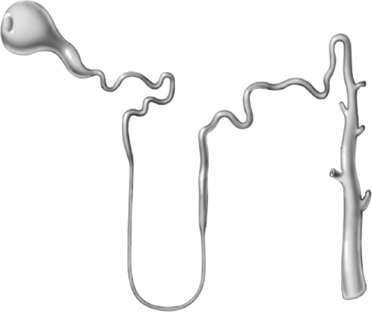

Renal glucose re-absorption in patients with diabetes^{1,2}
Filtered glucose load > 180 g/day
SGLT2
When blood glucose increases above the
renal threshold
(~ 11 mmol/L), the capacity of the transporters is exceeded, resulting in urinary glucose excretion
~ 90%
SGLT1
~ 10%
SGLT, sodium glucose cotransporter.
1. Adapted from: Gerich JE. Diabet Med. 2010;27:136–142; 2. Bakris GL, et al. Kidney Int. 2009;75;1272–1277.
Notes:
At a certain glucose concentration the glucose flux is to high and the glucose transport system becomes saturated . All the filtered glucose in excess of this threshold is excreted In the urine.

Slide 27
Urinary glucose excretion via SGLT2 inhibition¹
Filtered glucose load > 180 g/day
SGLT2
inhibitor
SGLT2 inhibitors reduce glucose
re-absorption
in the proximal tubule, leading to urinary glucose excretion* and osmotic diuresis
SGLT2
SGLT1
SGLT, sodium glucose cotransporter.
*Loss of ~ 80 g of glucose per day = 240 cal/day.
1. Bakris GL, et al. Kidney Int. 2009;75;1272–1277.
Notes:
SGLT2 inhibition lowers the Tm – the maximum re-absorptive capacity of the proximal tubule and lower the renal threshold for Glucose. Therefore, treated subjects will start to renally excrete glucose. The amount of excreted glucose is dependent on the Glucose filtration and therefore dependent on the blood glucose values. In the hypoglycaemic Range the amount of Glucose which is excreted will be very small and with rising blood Glucose the excreted glucose will also increase. Subjects with high baseline glucose will have a much higher glucose excretion rate than subjects which are near normal. In the PK/PD studies a UGE (urinary glucose excretion) of around 80 g/day was measured. The Glucose loss is associated with fluid loss (increase in urine volume), osmotic diuresis and of with caloric loss. (average of 240 cal/day)

Slide 28
24-week empagliflozin monotherapy versus placebo and sitagliptin
Change from baseline in HbA_{1c} over time
EMPA-REG MONO™: study 1245.20
0
Baseline
Week
Placebo
Empagliflozin 10 mg QD
Empagliflozin 25 mg QD
Sitagliptin
Number of patients analysed
Placebo | 212 | 211 | 186 | 173 | 158
EMPA 10 mg QD | 215 | 215 | 211 | 206 | 203
EMPA 25 mg QD | 221 | 221 | 208 | 204 | 203
Sitagliptin | 220 | 219 | 213 | 203 | 198
EMPA, empagliflozin; HbA_{1c,} glycosylated haemoglobin; QD, once daily; SE, standard error.
MMRM results, FAS (OC).
Roden M, et al. Lancet Diabetes Endocrinol. 2013;1:208–219.

Slide 29
24-week empagliflozin monotherapy versus placebo and sitagliptin
Change in FPG (mmol/L) over time
Baseline
Week
-1.0
(95% CI:
-1.3, -0.7)
p < 0.0001
-2.0
(95% CI:
-2.3, -1.7)
p < 0.0001
-1.7
(95% CI:
-2.0, -1.4)
p < 0.0001
EMPA-REG MONO™: study 1245.20
Number of patients analysed
Placebo | 211 | 211 | 183 | 169 | 154
EMPA 10 mg QD | 215 | 214 | 210 | 205 | 201
EMPA 25 mg QD | 220 | 217 | 206 | 203 | 200
Sitagliptin | 218 | 216 | 210 | 201 | 193
CI, confidence interval; EMPA, empagliflozin; FPG, fasting plasma glucose; QD, once daily.
MMRM, FAS (OC).
Roden M, et al. Lancet Diabetes Endocrinol. 2013;1:208–219.

Slide 30
24-week empagliflozin monotherapy versus placebo and sitagliptin
Change in body weight at Week 24
Empagliflozin
Sitagliptin
100 mg QD
(n = 223)
Comparison with placebo
Placebo
(n = 228)
10 mg QD
(n = 224)
25 mg QD
(n = 224)
0.5
(95% CI:
0.0, 1.0)
p = 0.0355
EMPA-REG MONO™: study 1245.20
-1.9
(95% CI:
-2.4, -1.5)
p < 0.0001
-2.2
(95% CI:
-2.6, -1.7)
p < 0.0001
Mean baseline
78.2 | 78.4 | 77.8 | 79.3
CI, confidence interval; QD, once daily.
ANCOVA, FAS (LOCF).
Roden M, et al. Lancet Diabetes Endocrinol. 2013;1:208–219.

Slide 31
52-week extension of empagliflozin monotherapy versus placebo and sitagliptin
HbA_{1c} over time
Placebo
Empagliflozin 10 mg
Empagliflozin 25 mg
Sitagliptin
Adjusted mean (SE) HbA_{1c} (%)
EMPA-REG EXTENDTM MONO
0
41
52
64
76
Week
Number of patients analysed
Placebo | 212 | 211 | 186 | 173 | 158 |  | 96 | 81 | 73 | 65
EMPA 10 mg | 215 | 215 | 211 | 206 | 203 |  | 156 | 144 | 134 | 132
EMPA 25 mg | 221 | 221 | 208 | 204 | 203 |  | 147 | 143 | 138 | 132
Sitagliptin | 220 | 219 | 213 | 203 | 198 |  | 134 | 123 | 114 | 108
EMPA, empagliflozin; HbA_{1c}, glycosylated haemoglobin; SE, standard error.
MMRM in FAS (OC).
Roden M, et al. ADA 2014, Abstract 264-OR.

Slide 32
52-week extension of empagliflozin as add-on to metformin in T2D
Change from baseline in body weight over time
Placebo
Empagliflozin 10 mg QD
Empagliflozin 25 mg QD
Week
0
24
52
76
Adjusted mean (SE) change from
baseline in body weight (kg)
EMPA-REG EXTENDTM MET
Number of patients analysed
Placebo | 158 | 158 |  | 85 | 70
EMPA 10 mg QD | 197 | 197 |  | 147 | 130
EMPA 25 mg QD | 185 | 185 |  | 133 | 121
EMPA, empagliflozin; QD, once daily; SE, standard error; T2D, Type 2 Diabetes.
MMRM in FAS (OC).
Merker L, et al. ADA 2014, Abstract 1074-P.

Slide 33
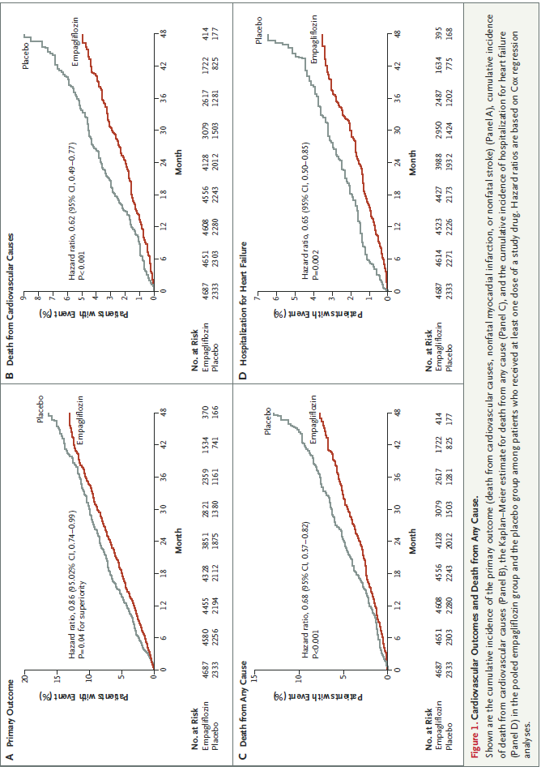
and SGLT2 agonist do this too!
N Engl J Med 2015; 373:2117-2128

Slide 34
Across all studies and empagliflozin
Improves Glycaemic control
  Reduction of HbA1c as monotherapy
  or with Metformin, Pioglitazone
  and as part of triple therapy
  or with insulin
Sustained weight loss
Reduction in SBP and DBP
Well tolerated
Reduce death rates (RRR 32% in Empa-Reg)
Notes:
the EMPA-REG OUTCOME study has shown that empagliflozin added to standard of care treatment reduced the risk of cardiovascular (CV) events in patients with T2DM who were also at increased CV risk. The risk of major adverse CV events (MACE: first occurrence of CV death, non-fatal myocardial infarction, or non-fatal stroke) was reduced by 14% relative to placebo (HR 0.86; 95.02% CI: 0.74-0.99; P = 0.04 for superiority). The risk of CV death was reduced by 38% relative to the placebo group (HR 0.62; 95% CI: 0.49-0.77; P < 0.001) and the risk of death from any cause by 32% (HR 0.68; 95% CI: 0.57-0.82; P < 0.001). Furthermore, empagliflozin was associated with reduced risk of hospitalization for heart failure and of renal adverse events. As well as EMPA-REG OUTCOME, empagliflozin has been studied in a number of clinical trials in patients with T2DM, in various combinations, including with insulin. Empagliflozin has shown significant improvements in glycemic control, body weight, and blood pressure, albeit improvements are limited in patients with declining renal function (estimated glomerular filtration rate <45 ml/min/1.73 m²).

Slide 35
GLP-1 agonists

Slide 36
Actions of GLP-1 agonists
Promote 1st phase insulin secretion
Reduce glucagon release
Delay gastric emptying
Weak satiety effect
Thus lowering blood glucose with modest weight loss without hypoglycaemia

Slide 37
Choice of GLP-1 receptor agonist:
short acting versus long acting
The pharmacological profile and half-life of a GLP-1 receptor agonist influences its effects on postprandial and basal (fasting) glycaemia
SHORT ACTING
GLP-1 receptor agonists
Lixisenatide OD, Exenatide BD
LONG ACTING
GLP-1 receptor agonists
Liraglutide OD, Exenatide/Dulaglutide QW
or
Effect on
FPG
Effect on
PPG
Effect on
FPG
Effect on
PPG
FPG = fasting plasma glucose PPG = postprandial glucose
Fineman MS et al. Diabetes Obes Metab 2012;14:675-88
Notes:
Speaker Notes
It is becoming increasingly apparent that the GLP-1 receptor agonist class can be subdivided into 2 types which result in different effects on fasting and postprandial glucose levels:
As a consequence of their pharmacological profiles, prandial GLP-1 receptor agonists such as exenatide and lixisenatide, have a greater effect on lowering postprandial glucose levels, than they do fasting glucose levels.
Similarly as a consequence of their pharmacological profile and more protracted half lives Non-prandial GLP-1 receptor agonists such as liraglutide and once weekly exenatide have relatively greater effects on fasting plasma glucose levels.
Reference
Fineman MS, et al. GLP-1 based therapies: differential effects on fasting and postprandial glucose. Diabetes Obes Metab. 2012;14(8):675-688.
Annotation
Fineman. Diabetes Obes Metab.January.2012/p1/lines A6-A8; p9/c2/table 3

Slide 38
GLP1 agonist and cost per month
Lixisenatide 20mg od; £54.14
Exenatide (10µg bd); £68.24
Byduron; £73.76
Liraglutide (1.2mg od); £78.48.
Liraglutide (1.8mg od); £117.72
Dulaglutide (1.5mg) ; £73 pm
IDegLira (50 dose daily); £159.22

Slide 39
When to use GLP1-agonists
HbA1c>58 mmol/l +oral agents;
  Overweight.
  With metformin/Pioglitizone/SGLT2 inhibitors.
    Stop DPP4 and Sulphonylureas.
Or with basal insulin;
  To avoid further weight gain.
  To reduce hypoglycaemia.

Slide 40
Weight loss and diabetes remission

Slide 41
Accessibility of surgery for T2DM
BMI (kg/m2) | Classification | Proportion T2DM
<18.5 | Underweight | 0.4%
18.5 – 24.9 | Healthy weight | 14%
25 – 29.9 | Overweight | 33%
30-34.9 | Obesity I | 29%
35 – 39.9 | Obesity II | 14%
40 + | Obesity III | 9%
National Diabetes Audit 2012-13
Notes:
BMI > 35 = 77% can’t access
BMI > 30 = 50% can’t access

Slide 42
Current approaches
‘Gold standard’ for weight loss however:
Criteria vary by region
Risks and side effects of surgery
Of those eligible, only 0.6% receive NHS bariatric surgery
Therapy gap between these approaches
More intensive programmes required
Vast majority who would benefit have their care at their GP practice
NHS/Commercial programmes
Commissioned for 5% weight loss
Only 2% achieve 15kg weight loss at 12 months

Slide 45
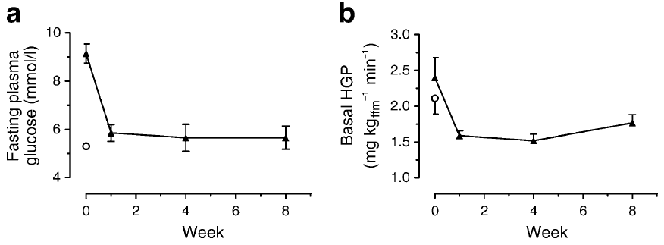
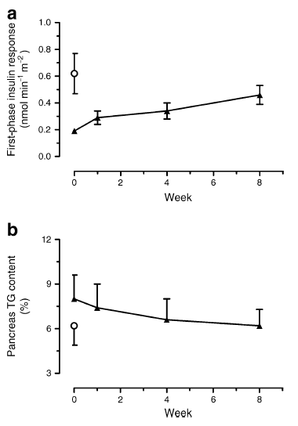
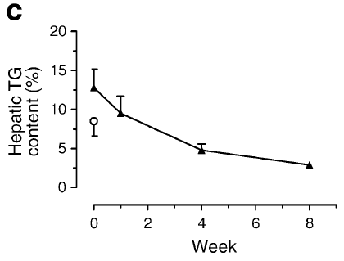
Reversal of Metabolic Abnormalities with VLCD
First phase insulin
response
Blood glucose
Liver glucose
production
Liver fat
content
Pancreas TG content
Lim et al. Diabetologia 2011; 54: 2506-14

Slide 46
Berkshire West VLCD Pilot Programme
Inclusion criteria are:
Type 2 diabetes of less than four years duration and body mass index of greater than 28 kg/m².
Exclusion criteria are
Any psychiatric disorder, particularly bipolar depression and schizophrenia and eating disorders
Substance abuse, including alcohol
Pregnancy or breastfeeding
Insulin or GLP1 treatment
Recent cardiovascular event including heart failure
A history of intermittent porphyria
Referral: Ian.Gallen@royalberkshire.nhs.uk
Theingi.Aung@royalberkshire.nhs.uk

