Slide 1
Managing mental health problems at work
Challenges and complexities
Dr Annie Irvine
Social Policy Research Unit

Slide 2
Outline
The impact of mental ill health in work
(1) Job retention: what works?
  Qualitative evidence
  Quantitative evidence
(2) Challenges and complexities
  Disclosure
  Presenteeism
  Academic culture
Discussion

Slide 3
The impact of mental ill health in work
16% of working age population affected
Accounts for 11.5% of working days lost
  21% of working days lost in HE
37% of work-related illness cases
68% of HEIs top reason for long-term absence
HE Sector = high stress but low absence
Sources: Mc Manus et al, 2016; ONS, 2017; HSE, 2016; UCEA 2016

Slide 4
What works: Qualitative evidence
Flexibility
  Hours
  Location
  Environment
Managerial and social support
  Understanding and sensitive line managers
  Positive co-worker relationships
  Effective absence management
Role adjustment
  Adjustment to duties
  Redeployment
  Re-employment
  Mindset

Slide 5
What works: quantitative evidence
No consistent predictors
Mixed trial outcomes (some counterproductive)
Overall evidence base weak and inconclusive
But therapy in isolation does not improve RTW
Challenge:
Managing mental health and employment is context-dependent and subjective

Slide 6
Challenges and complexities

Slide 7
Challenges and complexities
Disclosure
  Stigma
  Non-clinical ‘disclosures’
  Blurred boundaries: pressure > stress > illness
Presenteeism

Slide 8
Source: UCEA Sickness Absence in Higher Education Survey 2016

Slide 9





Slide 10
Challenges and complexities
Disclosure
  Stigma
  Non-clinical ‘disclosures’
  Blurred boundaries: pressure > stress > illness
Presenteeism
  Adjustment latitude
  Presenteeism paradox
Academic culture
  Long hours
  Permeable home-work boundaries
  Work as identity
  Excellence and perfectionism

Slide 12
Discussion

Slide 13
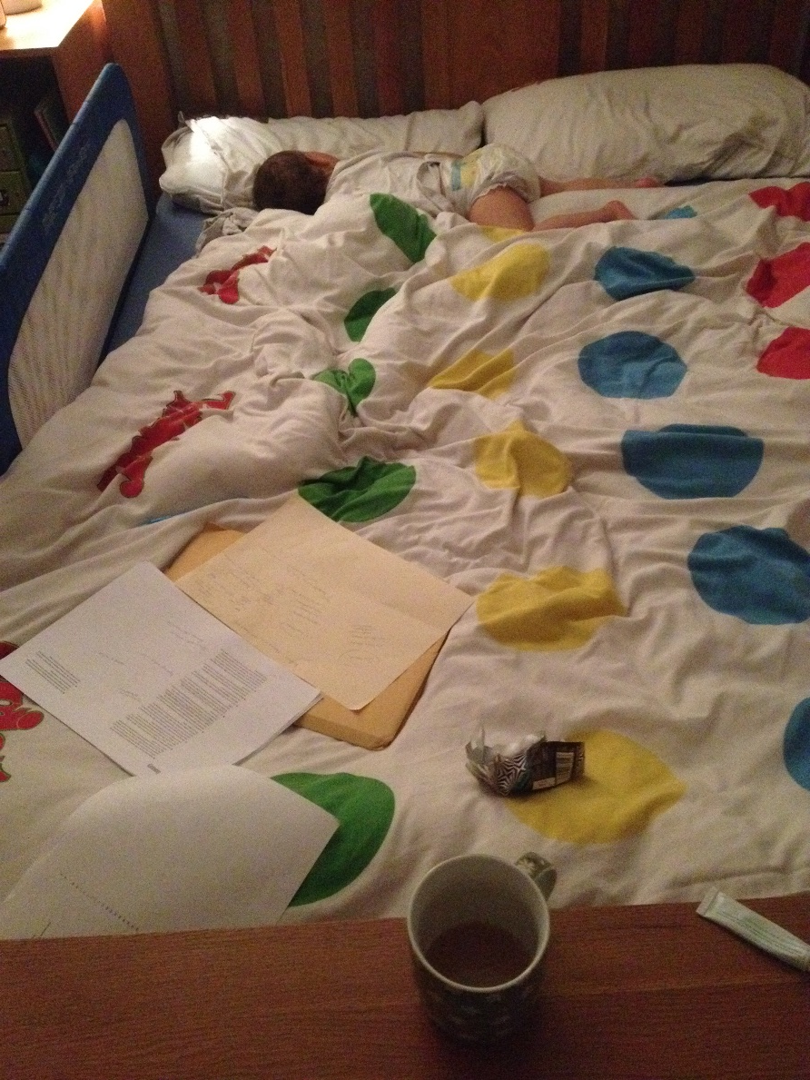
Thank you!
annie.irvine@york.ac.uk

